Slide 1
Outbound Call Implementation
AI-Powered Voice Agent with Twilio

Slide 2
Overview
This GenAI-powered outreach calling automates routine customer engagement, enabling bankers to redirect their efforts towards high impact activities. By handling initial and follow-up outreach calls with natural, banker like interactions, the solution reduces manual workload and empowers bankers to focus on building deeper relationships, uncovering financial opportunities, and delivering tailored solutions. The AI intelligently performs customer-requested actions based on call outcomes and supports multiple follow-up scenarios including Partner Referral, Complaint Teller, suggested Opportunity, and Pre call outreach. The result: Improved customer satisfaction, increased revenue potential, and optimized workforce efficiency across the entire customer engagement lifecycle.

Slide 3
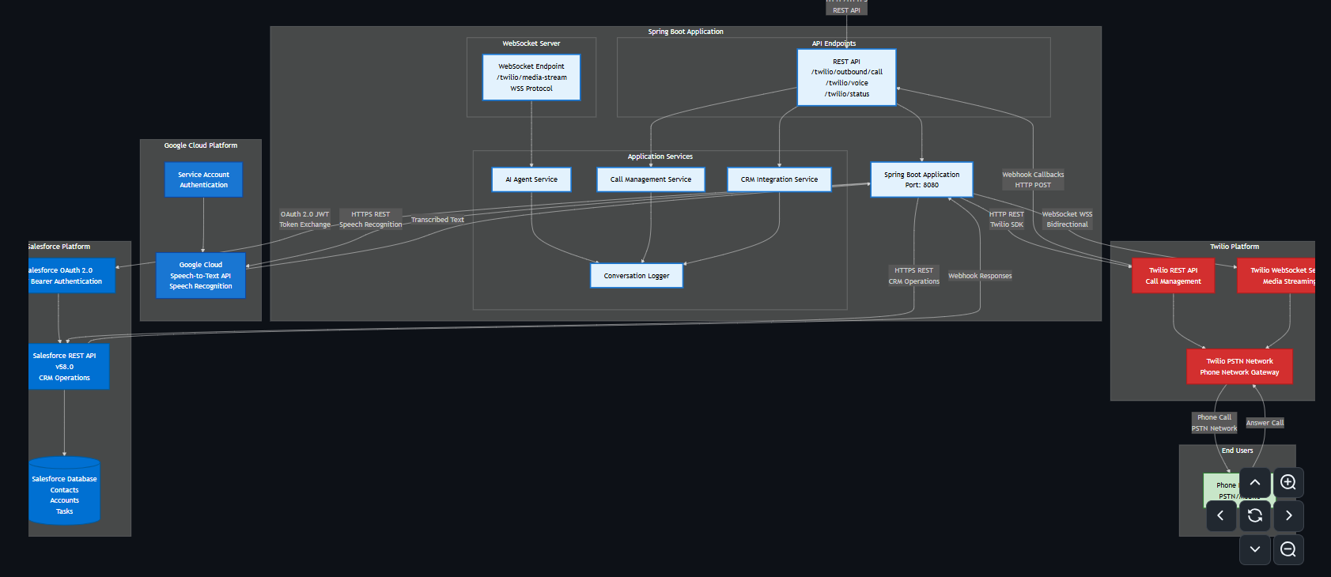
Notes:
Architecture

Slide 4
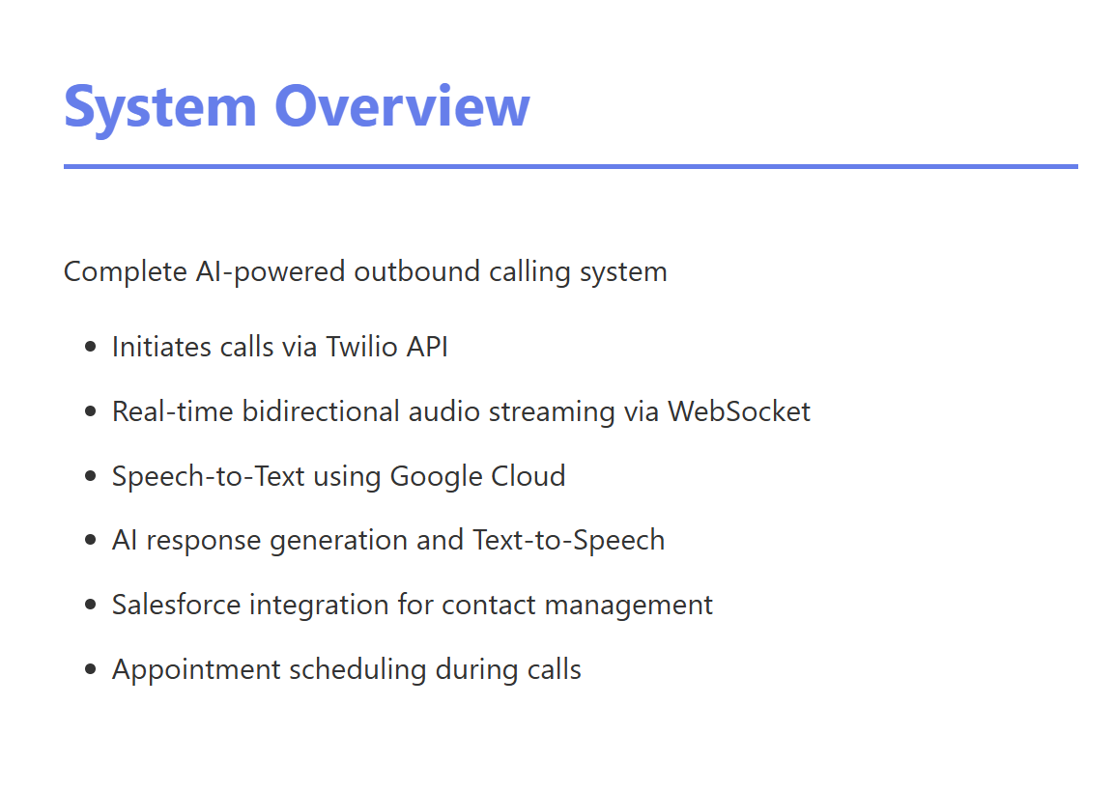

Slide 5
Dialog State Machine
Stage 1: ASK_BRANCH
User says 'schedule' or 'reschedule'
AI prompts for branch/location
Stage 2: ASK_DATETIME
Parses date/time (flexible formats)
AI prompts for date and time
Stage 3: Create Event
Creates Salesforce Event
Returns confirmation number

Slide 6
Salesforce Integration
Contact Lookup
Fetches Contact by ID before call
Extracts phone number (MobilePhone or Phone)
Uses Contact description as greeting
Call Context Storage
Stores Contact ID and Account ID
Links Call SID to Salesforce records
Task Creation
On call completion, creates Salesforce Task
Includes full conversation log
Links appointment confirmation if scheduled

Slide 7
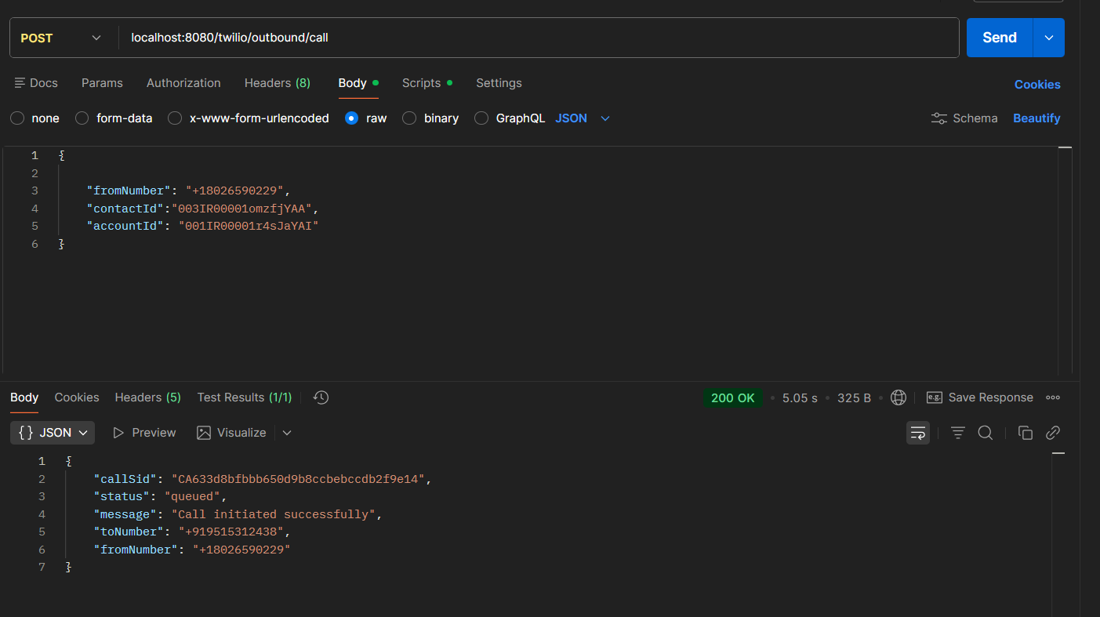

Slide 8
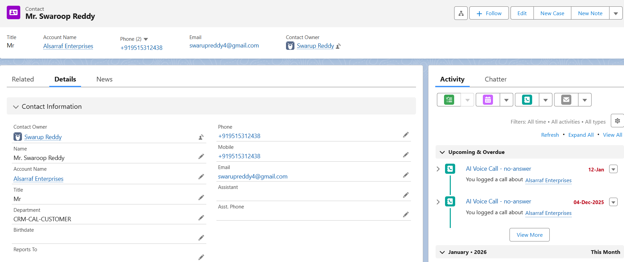

Slide 9
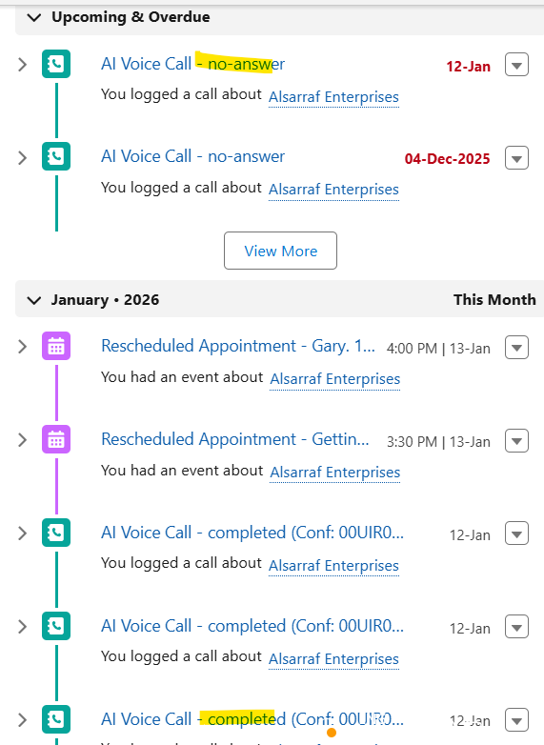

Slide 10
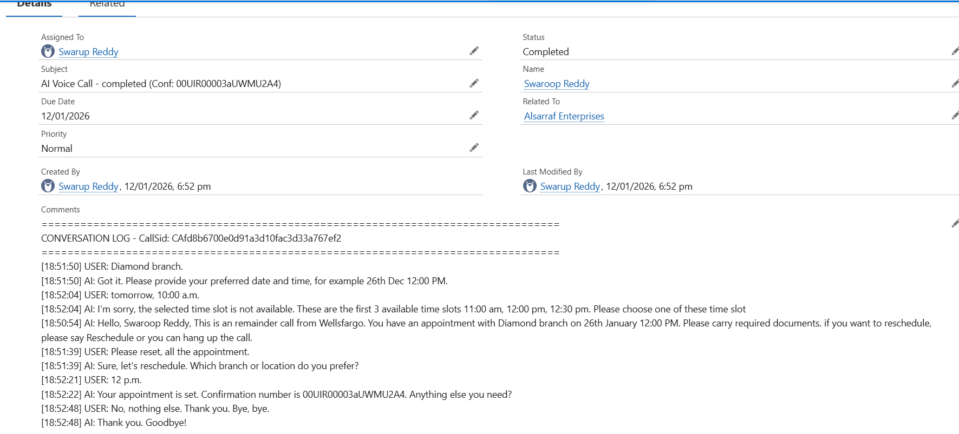

Slide 11
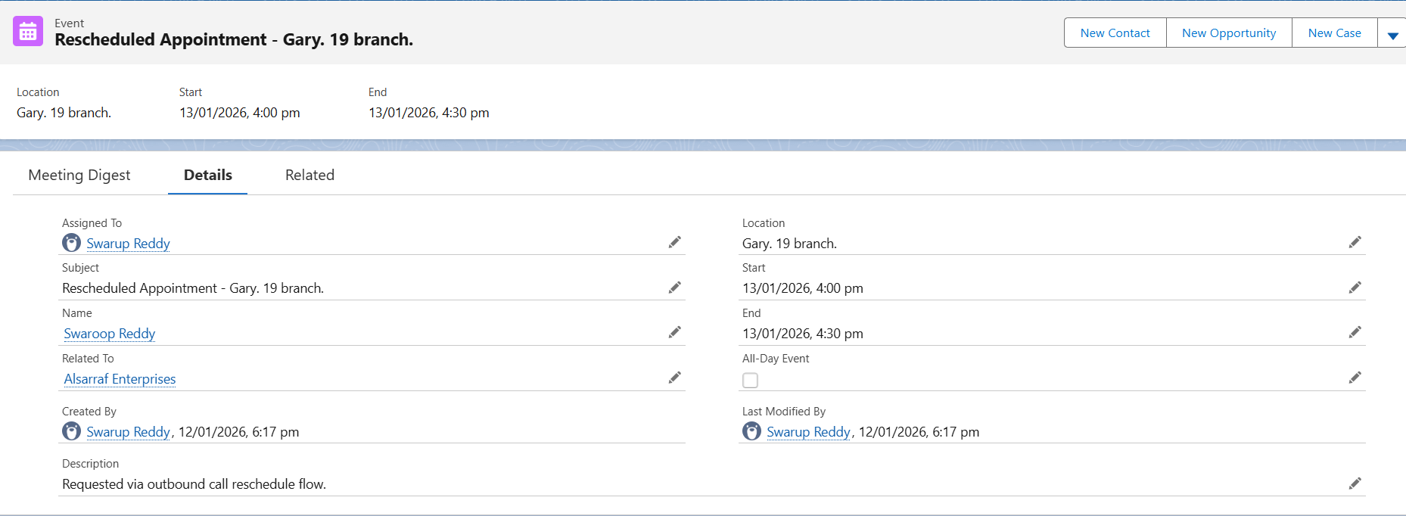

Slide 12

SNO | Use case | Call Recodring
1 | Remainder call
2 | Reschedule
3 | Reschedule when selected timeslot not available
4 | Reschedule when selected timeslot not available - 2

